Slide 1
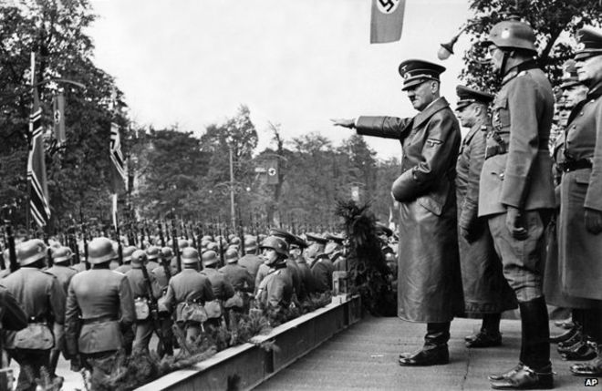
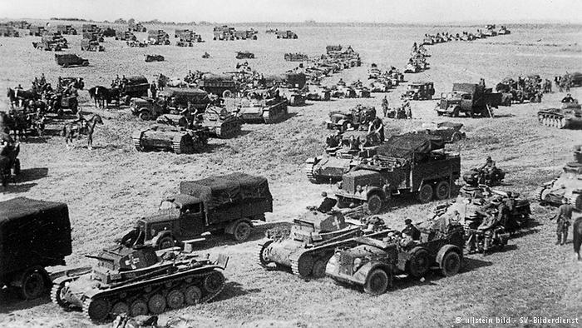
What was the international response to the start of war?
L/O – To understand how world powers reacted to the start of war in September 1939

Slide 2
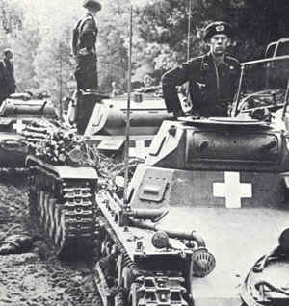
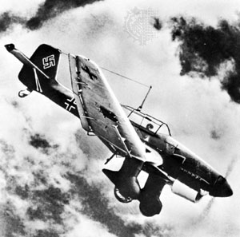
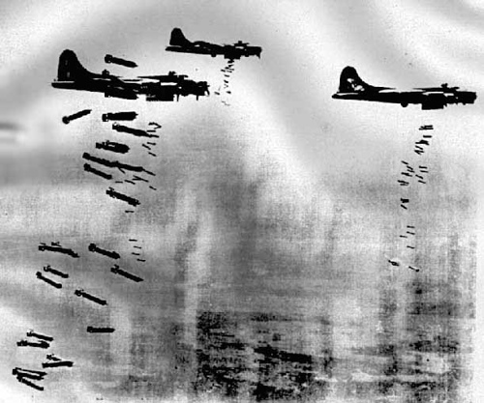
The Fall of Poland
On 1st September Nazi troops invaded Poland. On 3rd September, Britain and France declared war on Germany, in line with their March 1939 security guarantee they had given Poland.
Hitler believed that Britain and France wouldn’t want war over Poland – but this time he was wrong. Nevertheless, by the end of September he had won.
His victory was due to the new tactic of blitzkrieg. This utilised combined operations between fast moving panzer tank columns and mobile infantry, with precision air raids by the Luftwaffe.

Slide 5
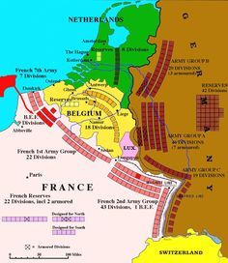
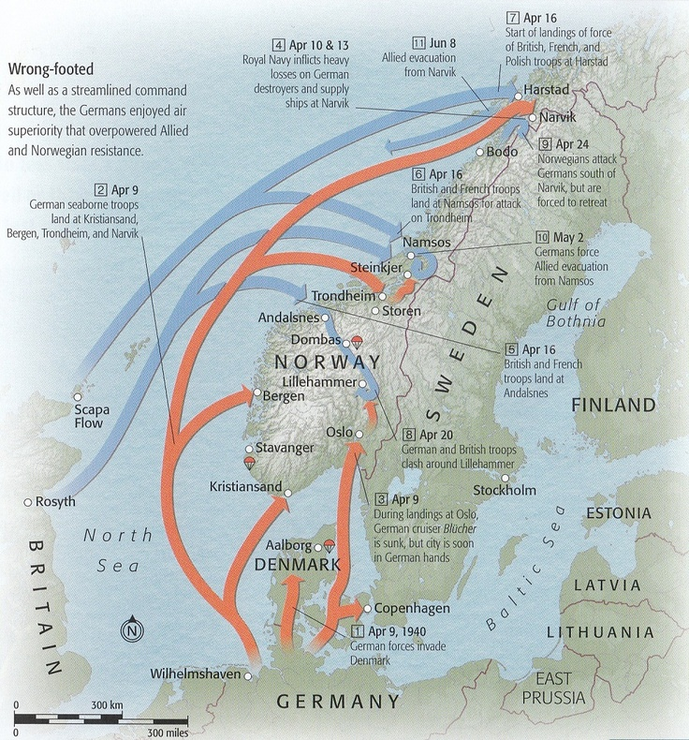
The Fall of Denmark and Norway
On 17th September, the USSR also invaded Poland from the East as stipulated in the secret protocols of the Nazi-Soviet Pact. Stalin also invaded the Baltic States and Finland.
Britain and France on the other hand did nothing immediately therefore the first months became known as the ‘Phoney War’.
Yet plans were openly discussed for an occupation of Norway to prevent German imports of iron ore from Sweden.

Slide 7
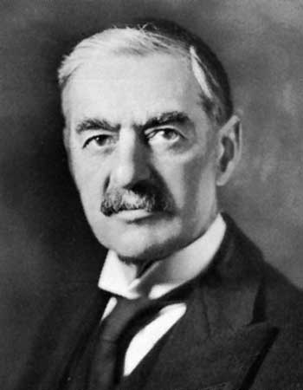
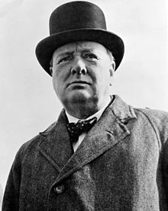
The Fall of Denmark and Norway
In March, a small British, French and Polish force was landed to secure Norwegian ports and mine their waters.
Unknown by the British, and to avoid being encircled, Hitler launched a full-scale in invasion of Denmark and Norway on 9th April. The invasion of Denmark took less than 6 hours, whereas Norway held out until 10th June.
The humiliation of a hurried British withdrawal from Norway led to the resignation of Neville Chamberlain. He was replaced by Winston Churchill who had done more than most to warn the world of the dangers of Hitler.

Slide 9
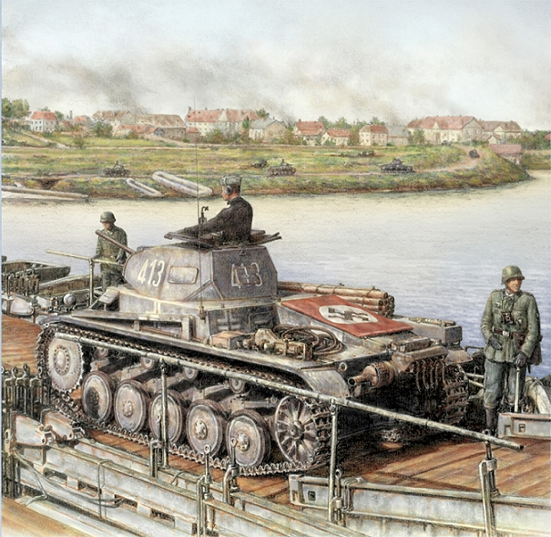
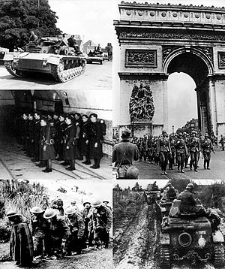
The Fall of France, Belgium and Holland
On the same day that Chamberlain stood down for Churchill, Germany launched its long-awaited attack on France and the Low Countries on 10th May 1940.
Bypassing the Maginot Line by pressing through the Ardennes, the Germans successful utilised blitzkrieg to invade France and quickly outflank the defending Franco-British forces.
At risk of complete encirclement, the entire British Expeditionary Force (BEF) of over 100,000 men fled to the port of Dunkirk.

Slide 10
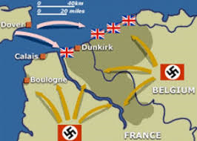
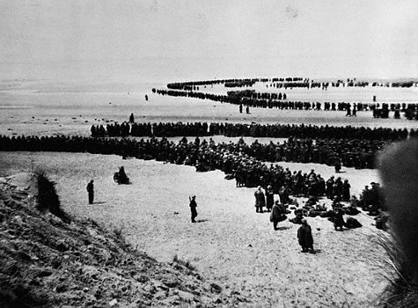
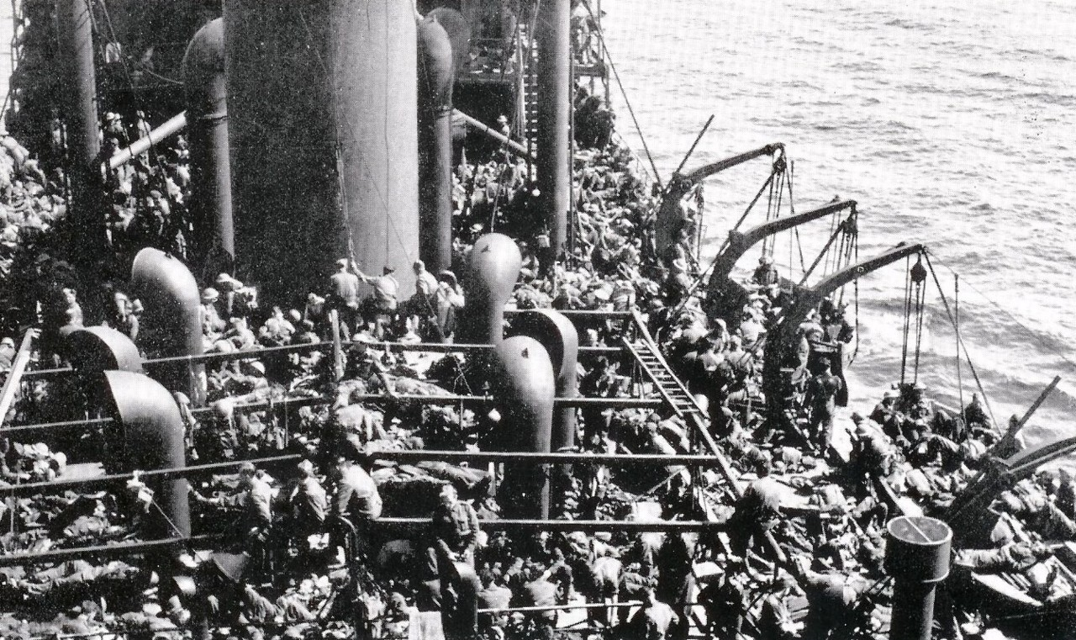
Operation Dynamo
Completely surrounded on three sides, it looked as if the entire British army as well as French and Belgian forces would be destroyed.
Yet the British attempted a full-scale evacuation. Codenamed ‘Operation Dynamo’, the British navy with civilian support launched an attempt to rescue these men.
Starting on 26th May and lasting 8 days, over 300,000 soldiers were rescued that otherwise would have faced death or imprisonment. Churchill hailed this as a ‘miracle of deliverance’.

Slide 11
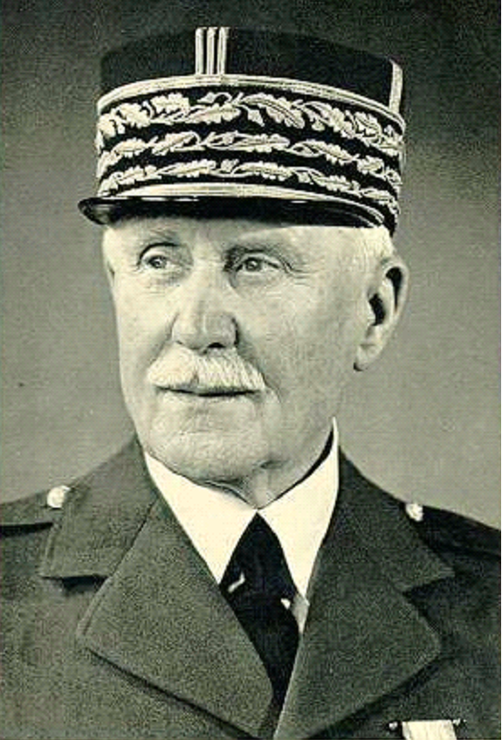
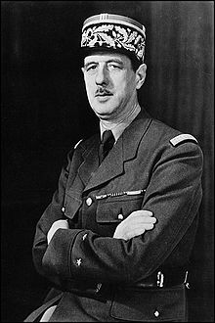
The Fall of France
Yet France had fallen to Germany. On 22nd June 1940 the French government surrendered.
The Germans took direct control of Northern France, whilst a puppet government was appointed in the South, led by Marshal Philippe Petain.
This government would become known as the ‘Vichy Republic’ and would collaborate with Germany. In London, the ‘Free French’ forces encouraged citizens to resist and were led by General Charles De Gaulle.

Slide 12
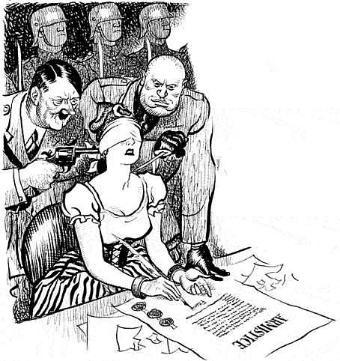

Slide 13
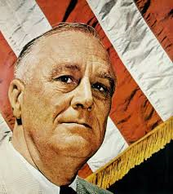
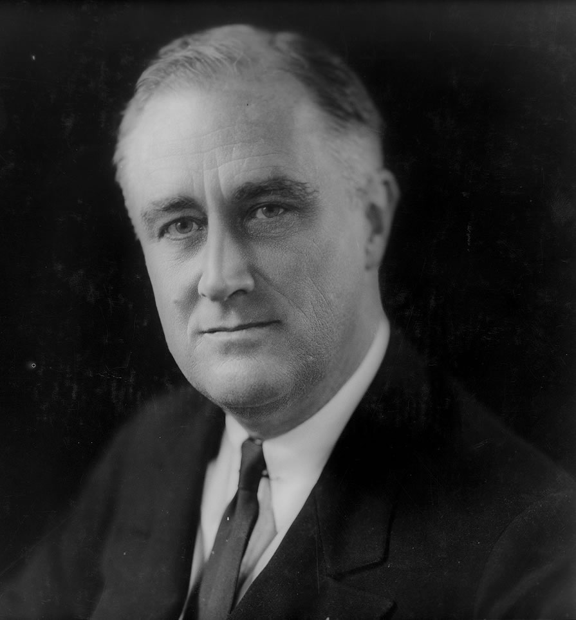
The Response of the USA
The immediate reaction of the USA to war was to declare neutrality as a non-belligerent. This was inline with a series of Neutrality Acts passed by Congress between 1935-39.
Yet in November 1939, under mounting pressure, a new Neutrality Act was passed which allowed belligerent nations like France and Britain to buy arms from the US, using their own ships.
The US feared that by banning all arms trade, it would only benefit Germany.

Slide 14
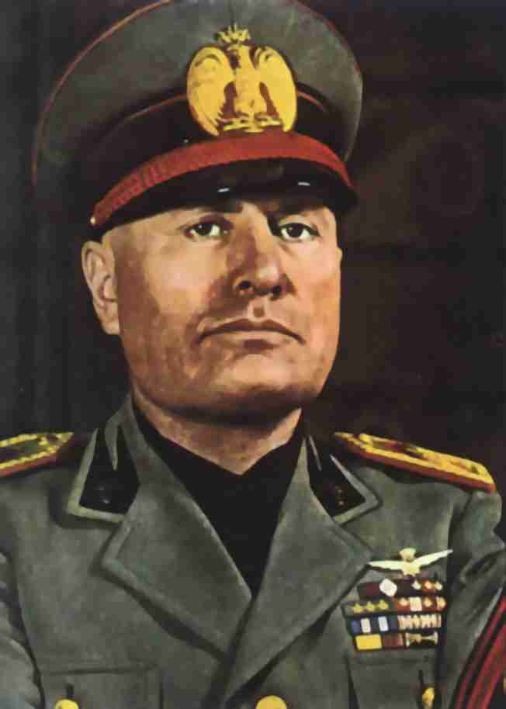
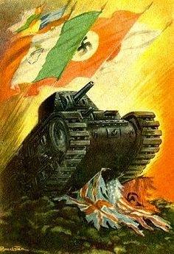
The Response of Italy
With the outbreak of war, Mussolini wasted no time in declaring Italian neutrality. Italy was in no way ready for war at this time.
Yet on 10th June 1940, Mussolini declared war on the allies, just as France was about to fall. There is debate as to whether Mussolini was trying to honour his alliance with Germany or merely keep pace with Hitler and not become a ‘junior partner’.
In September 1940, Mussolini launched an attack on British controlled Egypt as well as Greece. He failed in both. Germany had to divert vital troops and arms to support Italy, which delayed preparations for the invasion of the USSR.

Slide 15
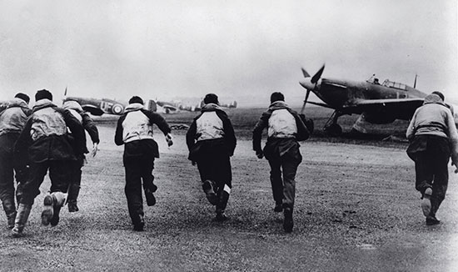
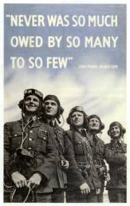
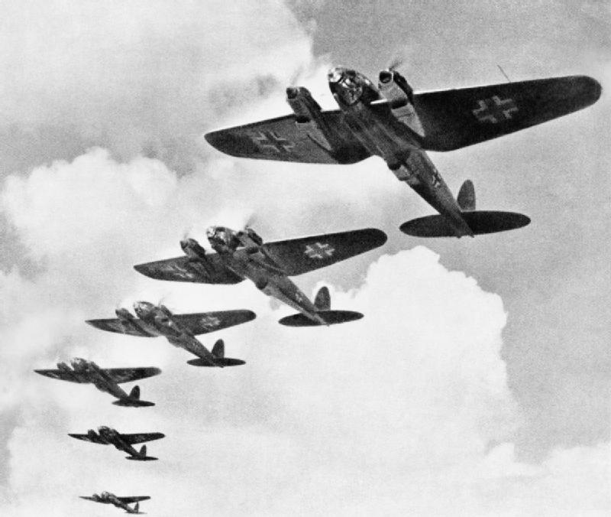
The Battle of Britain
By June 1940, Hitler had conquered all of mainland Europe. Only Britain held out as a threat. Plans codenamed ‘Operation Sealion’ were drawn up for the invasion of Britain.
Between July and September 1940, the Luftwaffe launched a preliminary bombing operation to destroy the Royal Airforce (RAF).
The battle for supremacy in the skies raged for 3 months with the Luftwaffe targeting British airfields. Yet the Germans didn’t manage to inflict a crippling blow, and Hitler was forced to delay and cancel his plans for invasion – his first major defeat of the war.

Slide 17
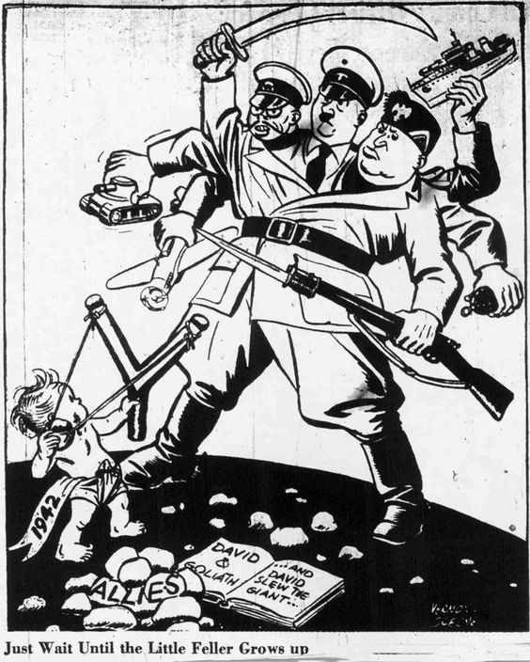
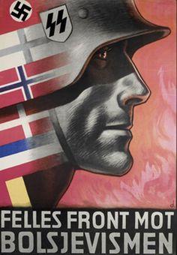
World War Two by 1940
By the end of 1940 Germany, Italy and Japan had consolidated their alliance with the September 1940 Tripartite Pact. In November, Hungary, Slovakia and Romania would join.
The ‘axis powers’ had taken control of all of mainland Europe, as well as most of China’s provinces.
With Soviet and US neutrality still in place, it enabled Hitler to reign supreme. Yet this would soon change in 1941.

