Slide 1
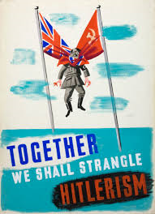
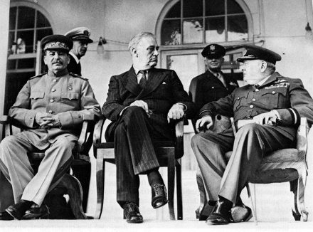
Who was to blame for the breakdown of the Grand Alliance?
L/O – To discuss and evaluate the role played by various factors in the outbreak of the Cold War

Slide 2
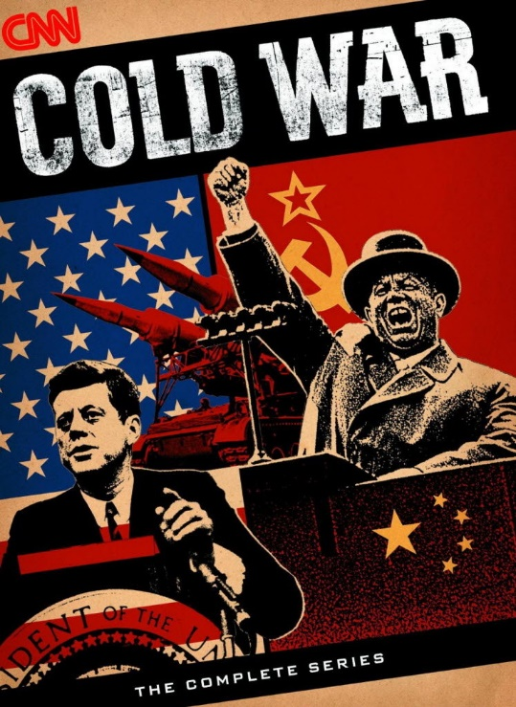
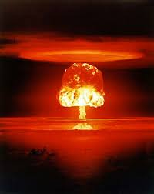
What caused the Cold War?
Views on this issue depend a lot upon how you view the nature of Cold War itself:
Was it a conflict about ideas and political systems?
Was it a conflict about rival economic systems?
Was it a conflict about Great Power Rivalry?
Rank these 3 factors in order of importance. Now get into groups. Using your notes, timelines and textbooks, put together a case arguing for one of the above factors. You will be judged on your evidence & arguments.

Slide 3
1. Role of Ideology
What examples, facts and details could we give to prove the Cold War was a result of ideology struggle? What events could we analyse to prove this?
Communism vs. Capitalism – 19th
Bolshevik Revolution 1917; Red Scare in USA: 1920s
Western attempts to destroy Communism 1918-22
Salami tactics used in post-war Europe; Czech Coup
COMINTERN, COMINFORM and worldwide revolution
Rise of Communist Parties post-war – Greece, France, Italy
Marshall Plan and ‘Dollar Imperialism’
US calls for ‘free trade’ and ‘democracy’ in Atlantic Charter and war conferences – American Imperialism?
Iron Curtain Speech, Stalin’s Speeches and Ideology
Western Liberal Democracy vs. Soviet Totalitarianism?
Stalinism = paranoid and hostile to outside world? (Gaddis)

Slide 4
2. Role of Economic Rivalry
What examples, facts and details could we give to prove the Cold War was a result of economic rivalry? What events could we analyse to prove this?
US economic policy – open markets, free trade, IMF, GATT, World Bank, Bretton Woods Agreement – free market capitalism? Threat to Soviet Planned Economy? Dollar Imperialism?
Marshall Plan – aim to prevent Communism by solving poverty in Europe?
COMECON – Soviet attempt to create economic sphere of influence? Imposed Stalinist economic systems
German Problem – Stalin feared economically powerful Germany, US wanted to export to Germany, West introduced new currency in its zones – led to Berlin Blockade
Iran Crisis 1946 – Stalin/West wanted control of Iranian Oil

Slide 5
3. Role of Great Power Rivalry
What examples, facts and details could we give to prove the Cold War was a result of Great Power rivalry? What events could we analyse to prove this?
Breakdown a result of traditional great power rivalry – a balance of power always emerges in history, especially in the power-vacuum of post-war Europe – now Superpowers
Alexis de Tocqueville (1835) – US and Russia seemed destined to control half the world
Both expansionist power – both needed to ‘feed’ their countries with raw materials, new markets, make the world safe for their countries
Kissinger (1980s) – Soviet policy a continuation of Tsarist empire building, US policy similar?

Slide 6
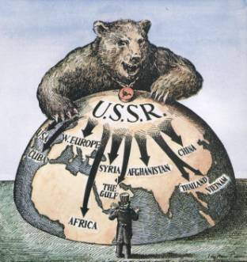
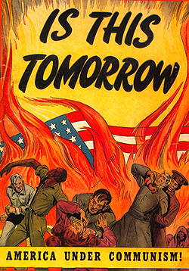
Was the war inevitable?
By viewing the Cold War as a result of either ideological, economic or great power conflict, we risk the danger of assuming that the Cold War was always inevitable. But was it?
Some historians have argued that war wasn’t inevitable but it was the actions of governments and individual leaders on both sides that increased tension. Which point do you agree with? Why? →
Was the USSR to blame?
Was the USA to blame?
Or were both guilty of misreading each other? Was it fear and suspicion of the other?

Slide 7
The USSR was to blame?
What examples, facts and details could we give to prove the USSR’s actions caused the Cold War?
Roosevelt said at Yalta that he wanted US troops gone from Germany within 2 years.
US expected USSR to be part of new global system – UN, IMF, Bretton Woods, ACC in Germany
Stalin disregarded promises at Yalta regarding Eastern Europe – used Salami Tactics to control
Remained in Northern Iran despite promises to withdraw
Berlin Blockade was aggressive
COMINFORM evidence of Stalin’s expansionism
Stalin promoted hostility to the West within the USSR

Slide 8
The USA was to blame?
What examples, facts and details could we give to prove the USA’s actions caused the Cold War?
USSR had legitimate security concerns – faced a hostile West since 1917, lost 20 million in war, weak economy – needed a buffer zone in Eastern Europe to prevent future attacks.
USSR’s actions stemmed from USA’s actions – atomic bomb threatening, USA determined to impose its own ideas on world.
Truman exaggerated Communist threat to Congress in order to defend its position in Europe
US viewed all Soviet actions as ideological – didn’t understand USSR’s need for security – saw as aggression
Introduction of new currency into Berlin was provocative, US wanted an anti-Soviet state
Establishment of NATO was an aggressive action

Slide 9
Were both sides to blame?
What examples, facts and details could we give to prove that fear and suspicion by both sides caused the Cold War?
The West and USA feared communism as a threat to its existence – its presence in the world would also be a threat
USSR’s actions were suspicious and expansionist – went against spirit of Yalta
Kennan’s Long Telegram presented a very fearful view of the USSR – needed to be stopped.
Developing Red Scare in USA increased paranoia! China, Korea, USSR atomic bomb in 1949 – confirmed fears?
USSR scared due to weak position after war – USA had strong economy, nuclear monopoly – US imperialism?
Stalin was a paranoid leader – totalitarian state meant his fear prevailed – lack of dialogue within USSR – unable to view US actions logically?

Slide 10
How have historians interpreted the Cold War?
At IBDP level, you need to show an awareness of the views, perspectives and interpretations of historians on the events you are analysing. We call this ‘historiography’.
Historiography = the study of the way history has been, and is, written – the history of historical writing.
L6 = ‘…some awareness and evaluation of different perspectives.’
L7 = ‘…there is evaluation of different perspectives, and this is integrated effectively into the answer.’

Slide 11
How have historians interpreted the Cold War?
When revising for IBDP history, and when writing essays, you therefore need to:
Understand the demands and implications of the essay question – practice ‘unpacking’ questions, looking for key command words
Make notes on and remember specific, accurate and relevant details about key events – timelines, detailed notes
Critically analyse events – break events down, review what happened and why, criticise and argue, develop your own thesis, back-up your views with specific examples
Evaluate Different Perspectives – acknowledge there are different views to your own, give examples of historians views, explain how your view sits within the wider historiography

Slide 12
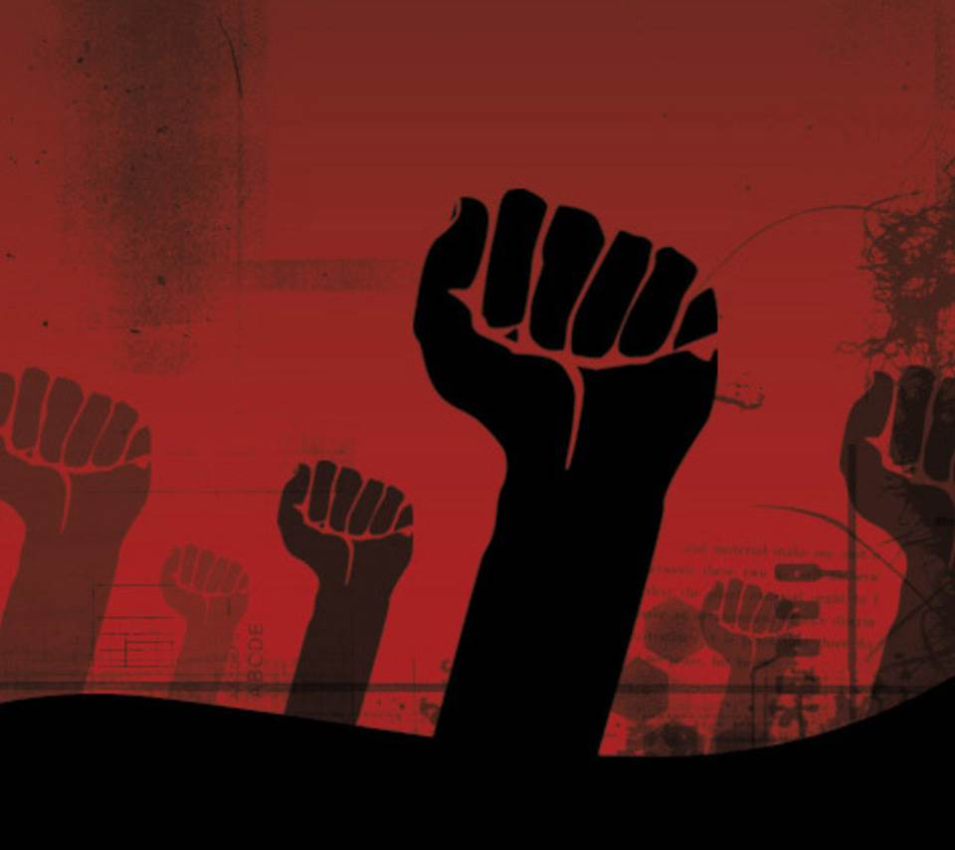
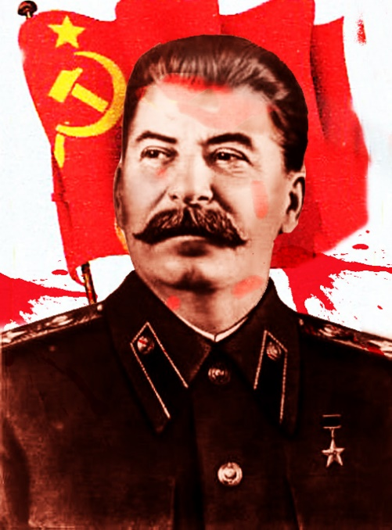
What do Orthodox historians think?
Orthodox historians believe that the USSR was to blame. These historians were writing in the 1950s/1960s and their narrative was shaped by that of the US government.
They argue that Communism was expansionist due to Marxist theory, and that they wanted world revolution against Capitalism.
Therefore they highlight Stalin’s role in violating Yalta and Potsdam, occupying Eastern Europe, planning revolutions in China and Asia. The USA ‘had to’ act defensively through the Truman Doctrine, Marshall Plan and NATO.

Slide 13
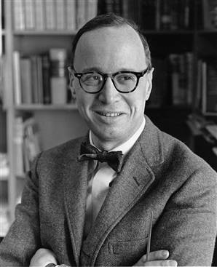
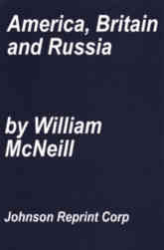
What do Orthodox historians think?
The most famous orthodox historian was Arthur M. Schlesinger Jr. who wrote the famous article, ‘Origins of the Cold War’ in Foreign Affairs magazine (1967).
‘Marxism-Leninism gave the Russian leaders a view of the world in which the existence of any non-Communist state was by definition a threat to the Soviet Union…’
Other orthodox historians have included William H. McNeill, Herbert Feis and Jerald Combs. Winston Churchill and George Kennan could also be considered shapers of the Orthodox perspective.

Slide 14
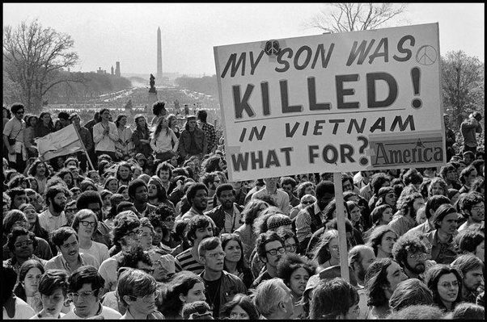
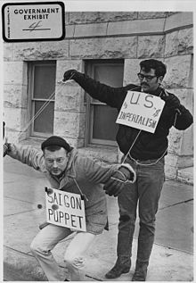
What do Revisionist historians think?
A new perspective emerged during the 1960s when many Americans began to question the actions of their own government over the controversial war in Vietnam.
They believed that the USA was responsible for the Cold War. They argue that US policy was linked to the needs of capitalism.
Containment was all about securing access to markets. US was aggressive and wanted to dominate the post-war world.

Slide 15
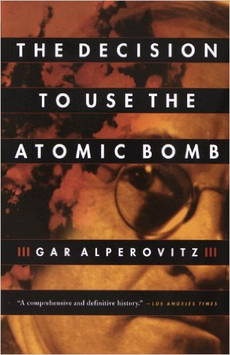
What do Revisionist historians think?
The most famous revisionist writer is William Appleman Williams who’s book ‘The Tragedy of American Diplomacy’ (1962) argued that US policy was a form of ‘dollar diplomacy’.
Other famous revisionists include Gabriel and Joyce Kolko, Gar Alperowitz and Walter LeFeber.
Gar Alperowitz has argued that the primary reason the atomic bomb was dropped on Japan was to ‘scare’ the USSR.

Slide 16
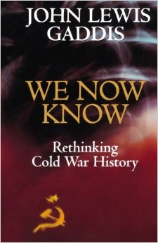
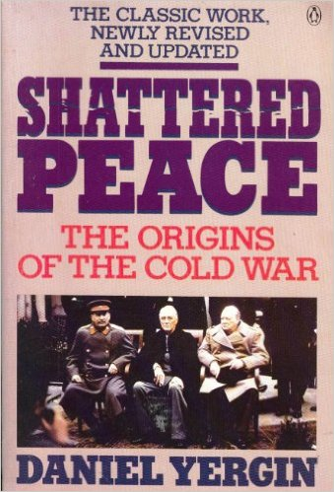
What do Post-Revisionist historians think?
A third perspective emerged in the 1970s and 1980s that questioned both the orthodox and revisionists.
US historian John Lewis Gaddis was a key proponent of this school and he argued that war grew out of complex misconceptions on both sides.
Both sides failed to recognise the needs of each other and both overestimated the strength of each side. Long-term factors made peace between them difficult.

Slide 17
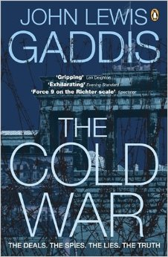
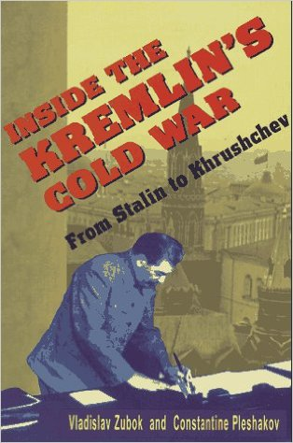
What do Post-Cold War ‘New’ historians think?
Since the end of the Cold War in 1989, many Soviet archives have been opened which have allowed historians to see events from the Soviet perspective.
This has led to a growing consensus that both sides were to blame, but that Stalin really was a crazy leader and his actions encouraged war.
The New historians, using new evidence, focus more on the role of individuals and their ideologies. John Lewis Gaddis, Daniel Yergin and Constantine Pleshakov.

