Slide 1
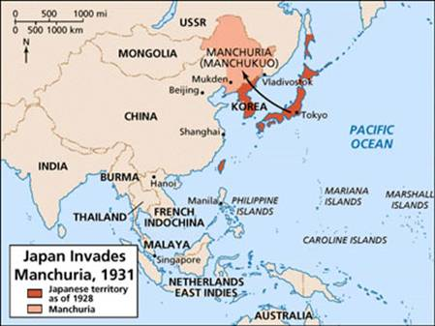
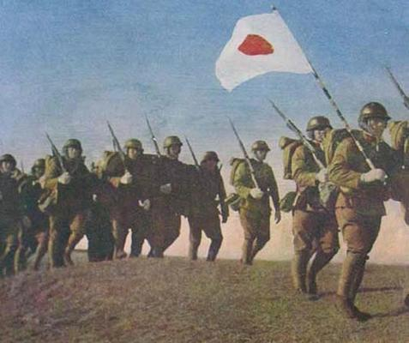
What was the response to the Invasion of Manchuria?
L/O – To analyse the domestic and international responses to the invasion of Manchuria

Slide 2
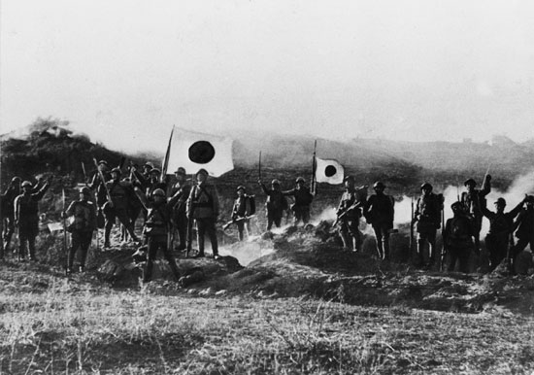
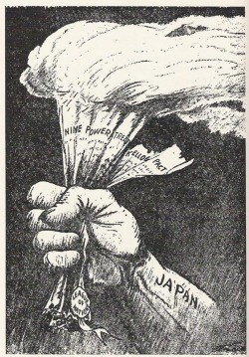
The Significance of the Invasion
The invasion of Manchuria was a significant turning point for Japan and China, changing the political and social geography of both countries.
Its colonial experiment launched in Manchukuo would transform Japanese policy towards China, locking Japan into a dynamic of ever increasing involvement that would result in war with China.
The invasion also catalysed anti-Japanese sentiment within China, creating popular forces that would lead Chiang Kai-shek to eventually oppose Japan.

Slide 3
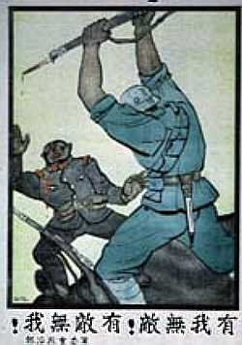
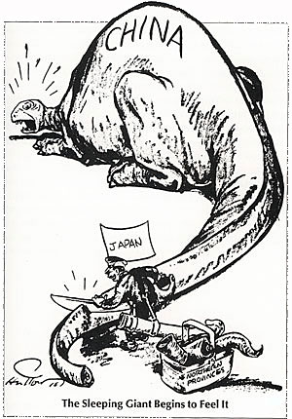
The Significance of the Invasion
The impact of the invasion upon international relations, as well as domestically, can therefore be examined in the following ways:
Impact on Japan – how the invasion influenced events in Manchuria and Japan
Impact on China – how the GMD and CCP responded to the invasion
Impact Internationally – how the LoN and other world powers responded

Slide 4
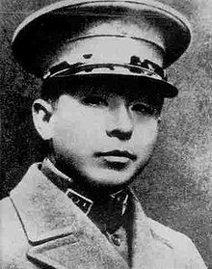
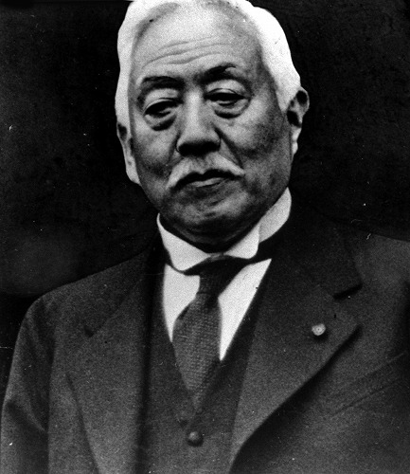
Impact on Japan – Growing Militarism
Whilst being outnumbered by Zhang Xueliang’s forces by 20:1, the Kwantung Army quickly moved to over-run the whole of Manchuria.
This was despite the Japanese governments’ attempts to halt army operations. Prime Minister Wakatsuki Reijiro would resign in December 1931 due to his failure to control the military.
He was succeeded by Inukai Tsuyoshi who had no choice but to make the occupation official government policy. Despite this, he was assassinated in the 15th May 1932 incident. Thus ended one of the last parliamentary cabinets. He was succeeded by Viscount Admiral Saito Makoto as Prime Minister in a ‘national unity’ cabinet.

Slide 5
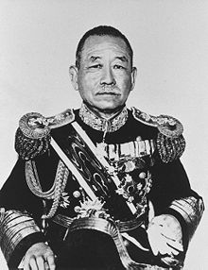
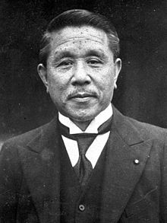
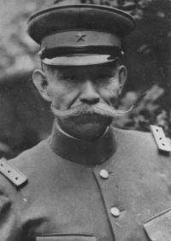
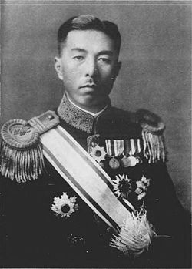
Impact on Japan – Growing Militarism
From 1932 onwards, Japan would be ruled by a series of national unity cabinets of senior bureaucrats and military men. The political parties would largely be ignored.
The military were able to exert almost total control over the cabinet, with the Army and Navy Ministers required to be serving officers.
With political power thus residing within the armed forces, the military became highly politicised. The success of Manchuria radicalised many young officers who now sought to control the direction of state policy.

Slide 6
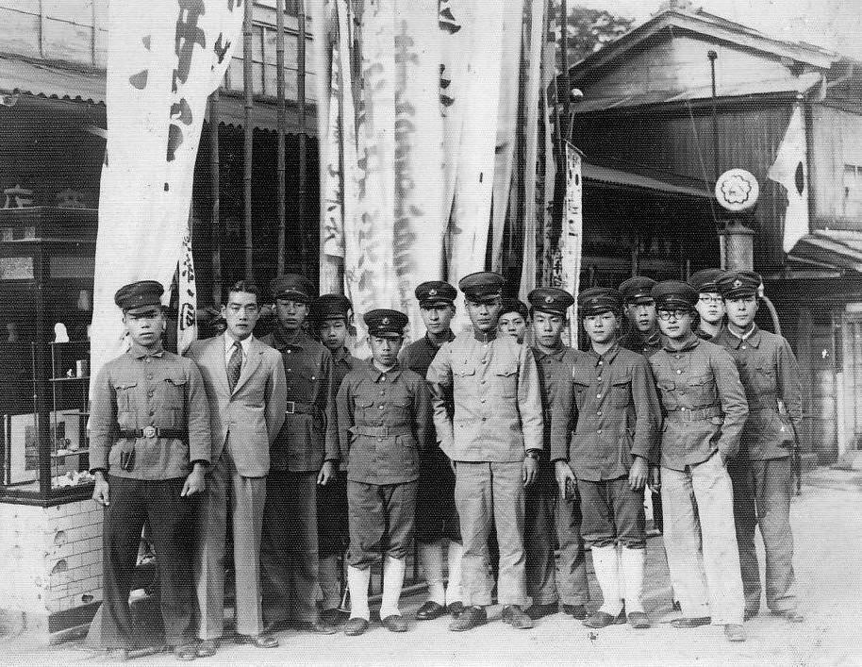
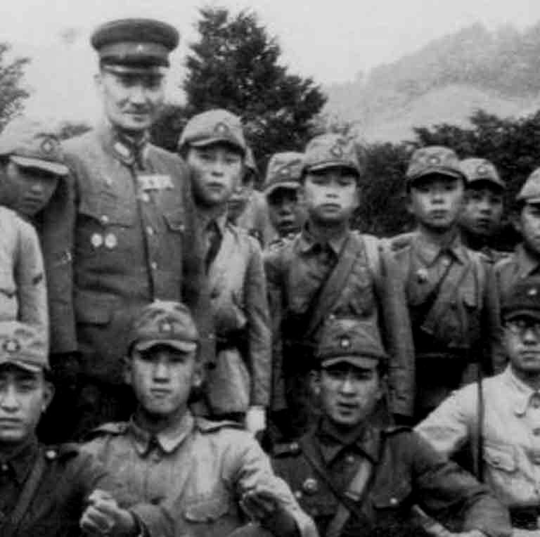
Impact on Japan – Growing Militarism
The Imperial Way Faction (Kodoha) – was a collection of secret ultra-nationalist groups amongst the armed forces and civilian society. Influence by Kita Ikki, they wanted to bring about a ‘Showa Restoration’ which would remove the corrupt, capitalist middle-classes and restore a direct link between the people and the Emperor. They wanted to avoid adventurism in China in favour of ideological war against the Soviet Union.
The Control Faction (Toseiha) – was an alliance of more pragmatic elder statesmen and younger technocrats. They believed that war with the West was inevitable, therefore Japan should utilise capitalism to prepare Japan for Total War. They favoured strengthening Japan’s position in China and Manchukuo.

Slide 7
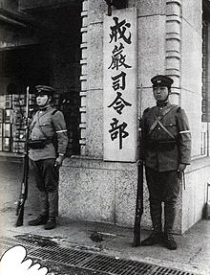
Impact on Japan – Growing Militarism
Tensions between the two factions came to a head in the ‘February Incident’ of 1936. On 26th February, thousands of Imperial Way officers attempted to take-over the government in Tokyo and enact a Showa Restoration.
Many members of the government were killed, however they failed to assassinate PM Keisuke Okada or control the Imperial Palace. After the Emperor publicly denounced the coup, many surrendered.
This time, 19 of the coup’s leaders were executed and more were imprisoned. The Control Faction used this as an opportunity to purge the army of Imperial Way supporters.

Slide 8
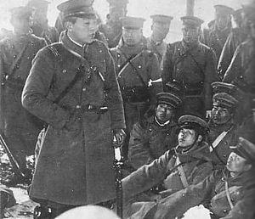
Impact on Japan – Growing Militarism
By the end of the year, Prime Minister Koki Hirota had given Army and Navy Ministers the right to approve all civilian appointments giving them a veto over the government.
Military control of education was further increased, and censorship of the media with the creation of a ‘United Press Agency’ in June 1936.
By playing upon the fears of the establishment the Control Faction was therefore able to ‘control’ Japanese politics.

Slide 9
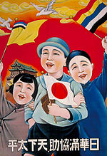
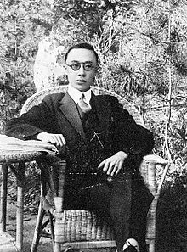
Impact on Japan – Manchukuo
The increasing militarism of Japanese society also impacted on Manchuria. By failing to reign-in the Kwantung army, Japanese forces in China simply became more emboldened.
They were aided in this by public support. ‘Manchukuo’ as it was renamed, captured the public imagination and united all Japanese around the ‘imperial project’.
It came to be seen as a promised land and a solution to Japan’s economic ills. Plans were developed turn Manchukuo into a Pan-Asian paradise, with Emperor Puyi re-instated as its head of state.

Slide 10
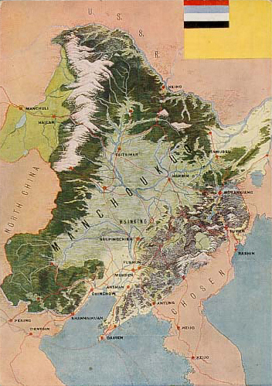
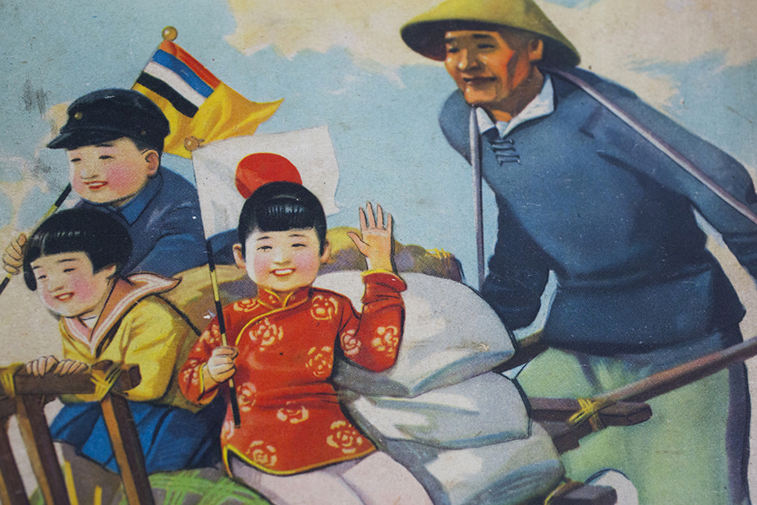
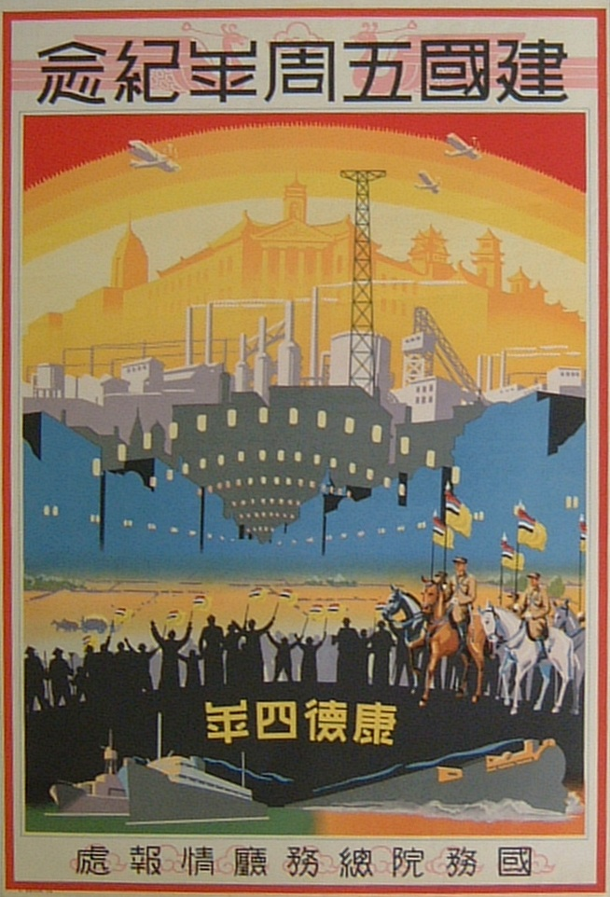
Impact on Japan – Manchukuo
Through the leadership of the Kwantung Army, Imperial Civil Service, and South Manchuria Railroad Company, Manchukuo’s economy boomed.
Plan were made to increase Japanese colonisation – by 1941 over 100,000 had emigrated, the road network was doubled, telegraph network tripled in size, airfields were built, cities created.
In total, Japanese investment was valued at 4 billion Yen between 1931-40, or £9 billion GBP! This economic boom helped Japan’s economy to recover faster. By 1936, Japanese exports had surpassed 1929 levels by 60%!

Slide 11
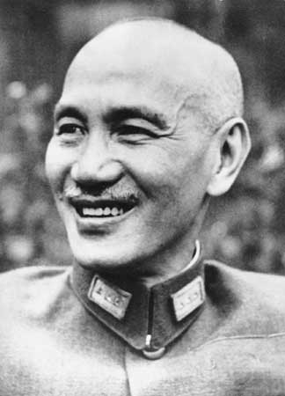
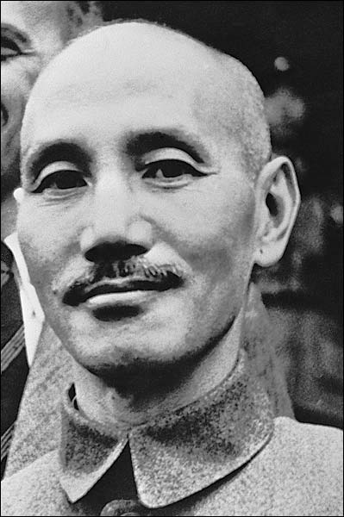
Impact on China – Anti-Japanese Protest
Within China, Chiang Kai-shek responded with a policy of ‘non-resistance, non-compromise, and non-negotiation’.
For Chiang, the GMD army was in no position to defeat Japan, especially consider that his control over China wasn’t complete, with independent warlords and the CCP still threatening his rule.
Yet the lack of a response only served to inflame passions amongst the Chinese public, who were increasingly angered by Ching’s inaction.

Slide 12
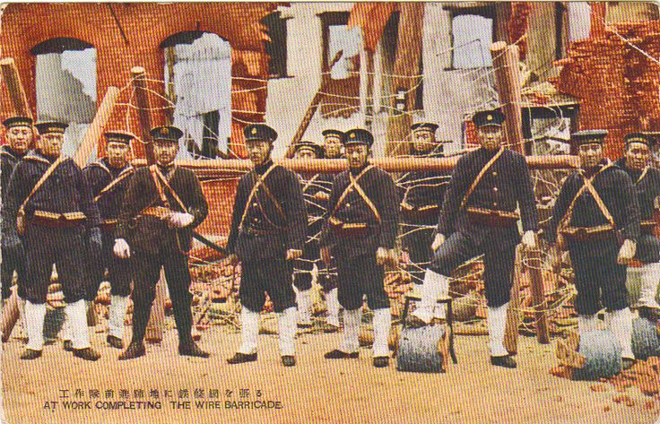
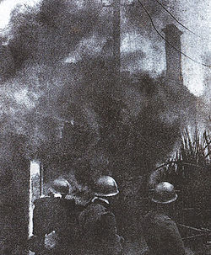
Impact on China – Anti-Japanese Protest
Anti-Japanese boycotts soon spread throughout China, with Japanese imports falling by 30% in 1931, and by 90% in 1932.
This anger is led to riots, especially in Shanghai. In January 1932, Japan sent 700 Marines and a fleet of destroyers into Shanghai to quell anti-Japanese riots which were spiralling out of control.
However a spontaneous Chinese resistance formed, with soldiers of the local Nineteenth Route Army, and Green Gang joining together to put up stiff resistance.

Slide 13
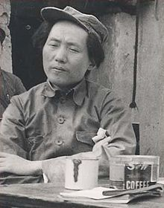
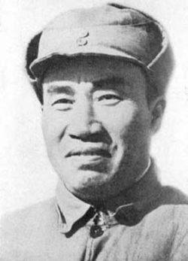
Impact on China – Anti-Japanese Protest
By the 3rd March ceasefire, Japan had sent over 3 army divisions to Shanghai to beat back the Chinese opposition. The Invasion of Manchuria had clearly galvanised opposition to Japan.
The burgeoning Chinese Communist Party were a direct recipient of this national mood. Between 1931-34, over 120,000 had joined the Red Army in its Kiangsi province Soviet.
Chiang Kai-shek also realised the need for rearmament. With German support, over 300,000 GMD troops were trained, supplied with the latest German weaponry. By 1935, 60% of German arms exports went to China!

Slide 14
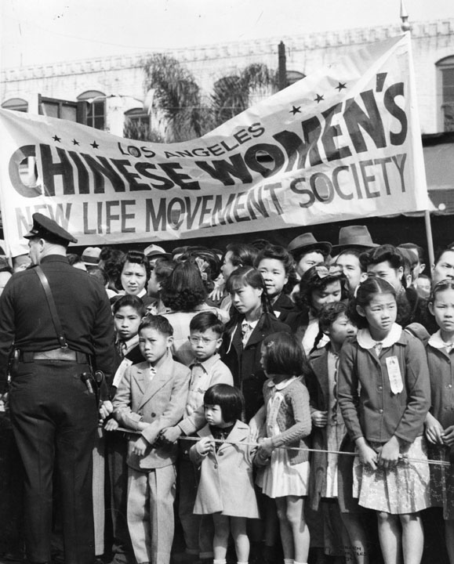
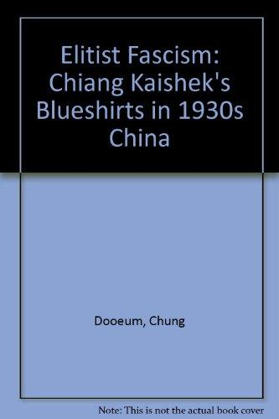
Impact on China – Anti-Japanese Protest
Chiang also rapidly moved to consolidate his position in China. With the CCP assumed to have been defeated in 1935, he launched a series of consolidation programmes.
His ‘New Life Movement’ sought to reinvigorate political life whilst the short-lived ‘Blue Shirts Movement’ saw an attempt to enforce his control.
Currency reform, social welfare improvement, a refocus on exports – all helped Chiang to consolidate his power within China.

Slide 15
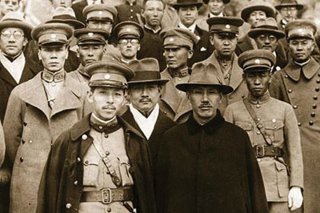
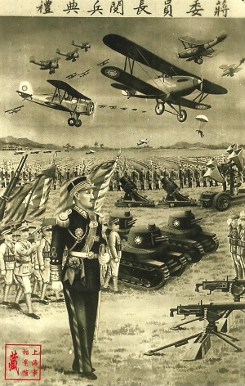
Impact on China – 2nd United Front
Despite these attempts at self-strengthening, Chiang was still reluctant for form a coalition with the CCP.
The USSR, seeing a second united front as the best way to deter Japanese aggression, encouraged the CCP to seek an alliance with the GMD.
In December 1936, Chiang was kidnapped by Zhang Xueliang whilst visiting troops in Xi’an. In intense negotiations with the CCP, Chiang publicly announced the Second United Front. Anti-Japanese resistance was now galvanised around Chiang’s leadership.

Slide 16
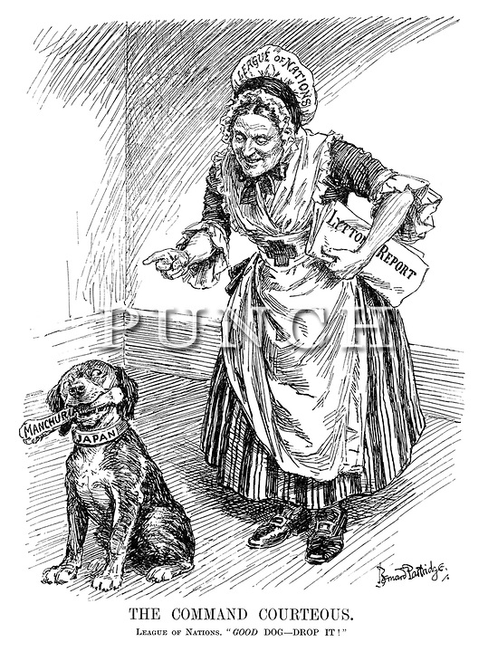
Impact Internationally
Immediately after the invasion, Chiang had called on the League of Nations to intervene in the crisis. The LoN responded with an ‘International Commission of Enquiry’.
Japan was initially uncooperative, ignoring demands to withdraw troops. Yet by January 1932, having conquered Manchuria, Japan decided to accept an enquiry.
Lord Lytton, the Viceroy of India, was dispatched to investigate. His findings published in October 1932 was surprisingly sympathetic to Japan but condemned the invasion.

Slide 18
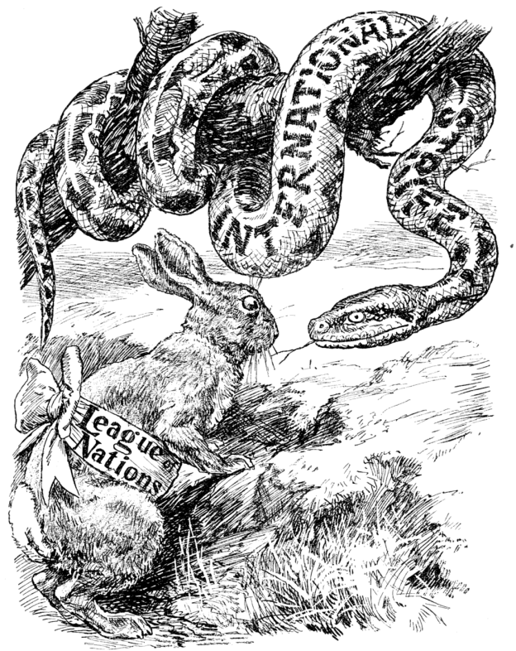
Impact Internationally
The League could have responded to the invasion with military or economic sanctions, yet major world powers were reluctant to do so.
The role of Britain was essential as it alone amongst the Council of the League was in a position to enforce military sanctions with its navy.
Yet many in Britain were sympathetic to Japan – Western nations were also fed-up with instability in China. Clearly, action against Japan would only have emboldened extremists in government.

Slide 19
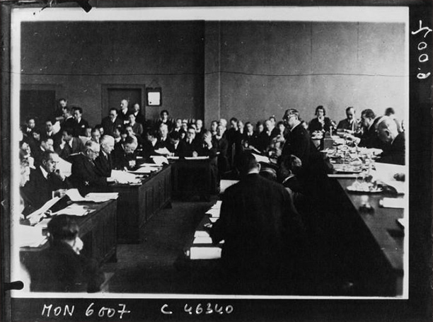
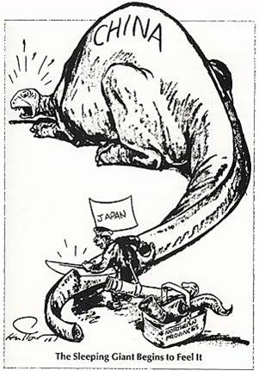
Impact Internationally
On 24th February 1933 the Council of the League voted 42-1 to accept the Lytton Report.
Japan responded by withdrawing its membership of the League in March 1933. Japan was left isolated internationally, yet this only encouraged Japan to act even more unilaterally in northern China.
In March they annexed Jehol province and the May 1933 Tanggu Truce between Japan and China created a DMZ over 100 km south of the Great Wall, in Hopei province. By 1935, this DMZ was extended to Chahar province.

Slide 20
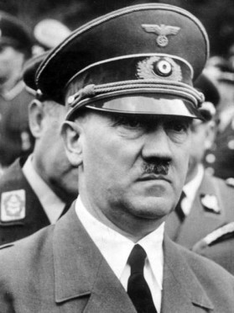
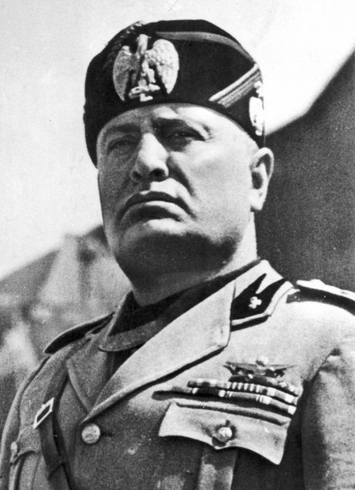
Impact Internationally
Further away in Europe, the lessons of the invasion were being noted by the rising tide of fascist governments.
The failure of the League to confront Japanese aggression emboldened Hitler to take Germany out of the League in 1933.
Mussolini would also leave in 1937. The whole concept of collective security was damaged by the Manchurian Invasion.

Slide 22
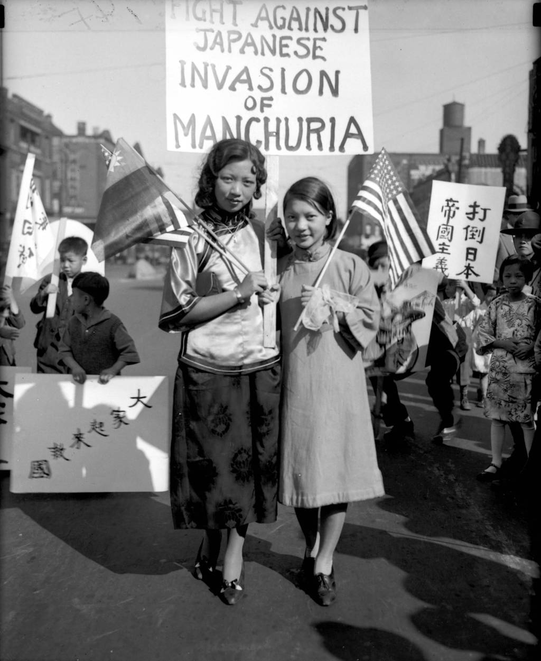
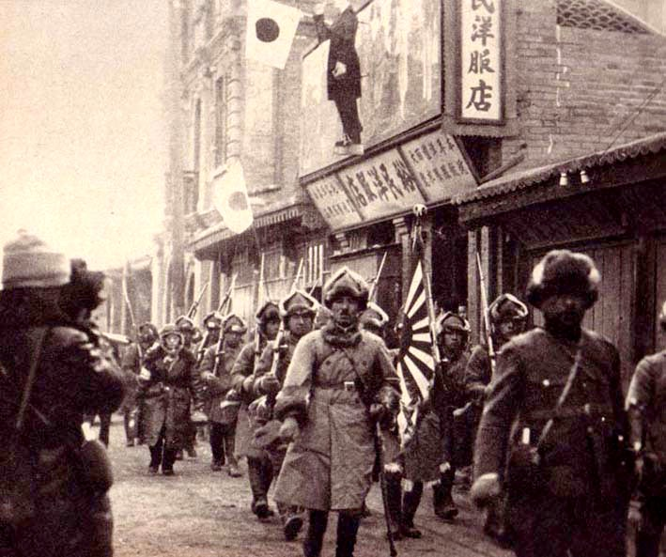
Plenary
The invasion of Manchuria was therefore a clear turning point for Japan. Internally, it destroyed any remaining legitimacy of the civilian government, resulting in the militarisation of politics.
In China, it drew Japan economically and politically into increasing involvement. It galvanised the Chinese into opposing Japan, laying the foundations for war.
Internationally, it isolated Japan, ending any hopes for cooperation with the West and putting Japan on a course of military confrontation.

