Slide 1
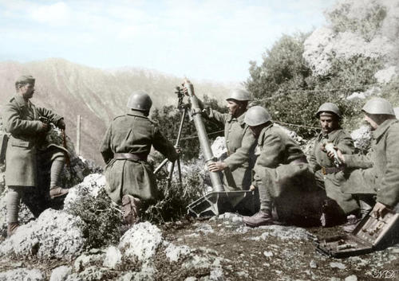
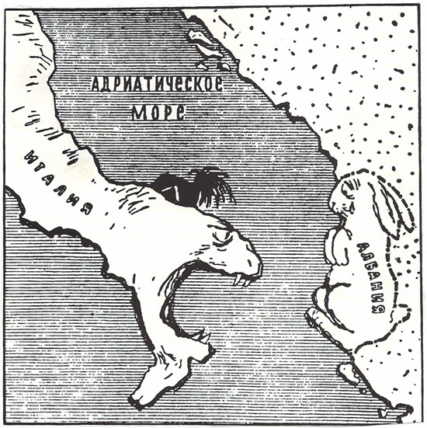
How did Italian foreign policy change after Abyssinia?
L/O – To examine how Italian foreign policy changed between 1936 and 1939

Slide 2
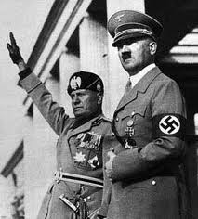
Europe after Abyssinia
The invasion of Abyssinia was a turning point in international relations. The credibility of the League of Nations and the whole concept of collective security was destroyed by the very member states who were on its Council!
The failure to confront Italian expansionism only emboldened Hitler to risk marching troops into the Rhineland in 1936.
Public admonishment of Italy by the British and French only served to push Mussolini into a closer alliance with Germany, both signing the Rome-Berlin Axis in Oct 1936. The alliance to contain Germany was now in disarray.

Slide 3
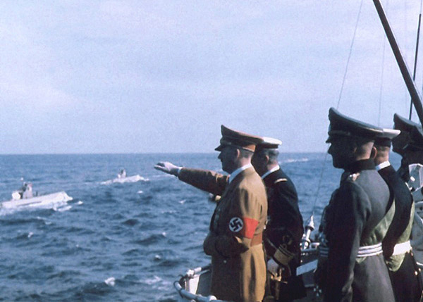
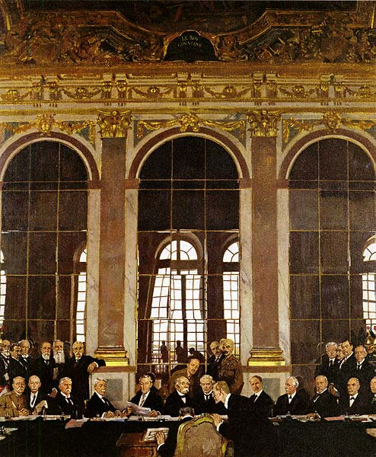
Europe after Abyssinia
Yet Mussolini cannot take all the blame for destroying any hopes of containing Hitler. Even before Abyssinia in June 1935, Britain and Germany signed the Anglo-German Naval agreement.
Fixing the tonnage of the Kriegsmarine to 35% of Royal Navy levels, Britain had hoped to contain Germany expansionism. Yet it allowed Germany to build a navy larger than Treaty of Versailles limitations! If the treaty could be broken in this way, then how else could it be broken?
Signed without the knowledge of Italy or France, this miscalculation by the British undermined the post-war order based on the ToV, allowed Germany to rearm, and weakened the Stresa Front against Germany.

Slide 4
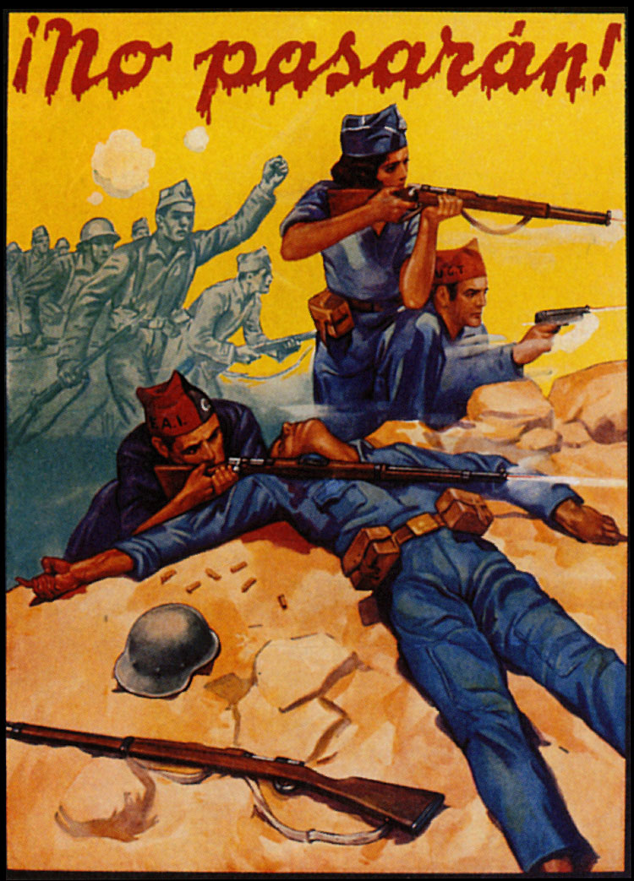
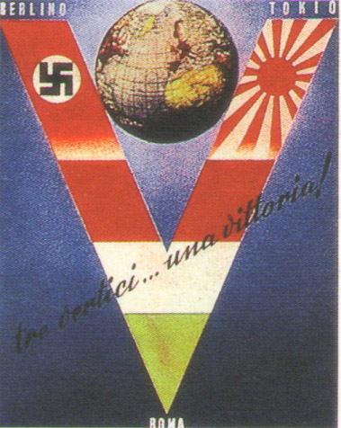
Changing Diplomatic Alliances
By 1936, out of isolation and hedging his bets, Mussolini moved Italian foreign policy away from its ‘equidistance’ policy towards full cooperation with Nazi Germany.
Both nations intervened in the Spanish Civil War in July 1936 in support of Franco’s regime. Mussolini hoped a friendly Spanish regime would prevent British and French control of the Mediterranean.
By 1937, Mussolini had signed the Anti-Comintern Pact with Germany, left the League of Nations, and have signed further cooperation agreements with Yugoslavia.

Slide 5
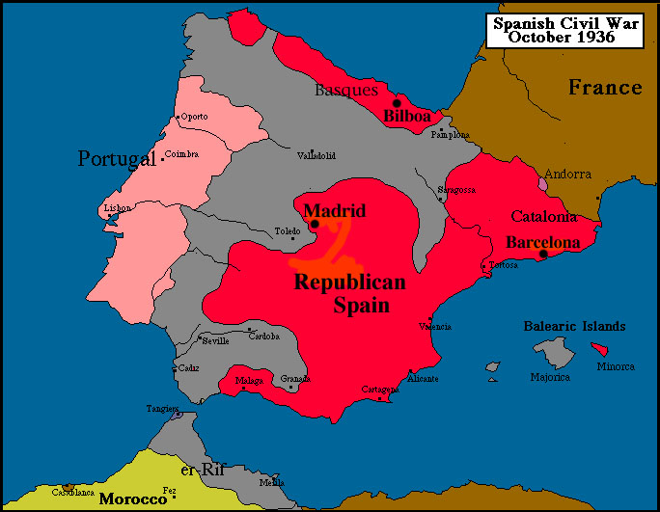

Slide 6
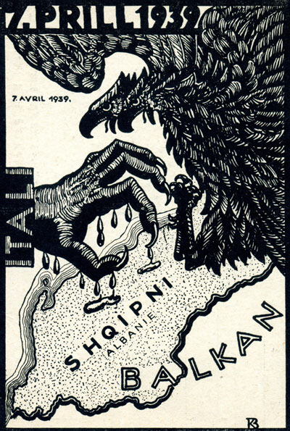
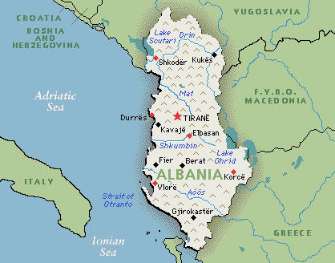
The Invasion of Albania
Since 1926, Italy had established a virtual protectorate over Albania, helping King Zog I into power in 1928.
Italian influence increased after the Great Depression, with Italy gaining access to Albania’s oil and mineral deposits.
Albania provided Italy with a toehold in the Balkans which was Italy’s natural area of expansion. In April 1939, Mussolini finally invaded Albania deposing King Zog.

Slide 7
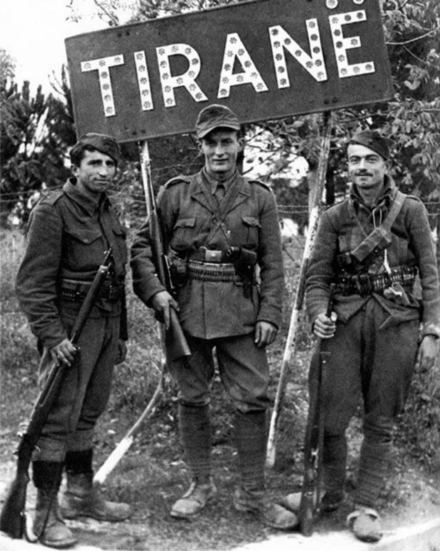
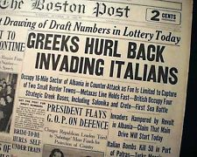
The Invasion of Albania
Whilst there were clear economic and geopolitical benefits to gaining control of Albania, Mussolini was also concerned to strengthen his alliance with Hitler.
Mussolini feared being the ‘junior partner’ in their alliance. By 1939, Hitler had regained the Rhineland, annexed Austria and the Sudetenland, Bohemia and Moravia from Czechoslovakia.
Mussolini therefore sought to showcase the strength of the Italian army as a way to maintain his credibility and negotiating power within the alliance. By October 1940, Mussolini would use Albania as a staging ground for his disasterous invasion of Greece.

