Slide 1
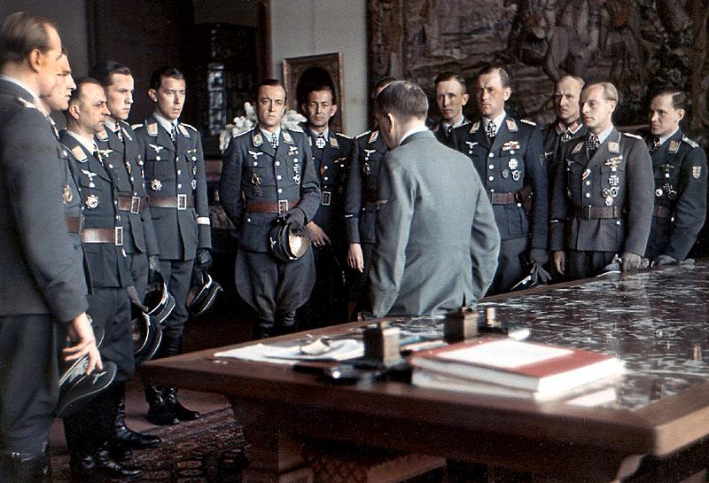
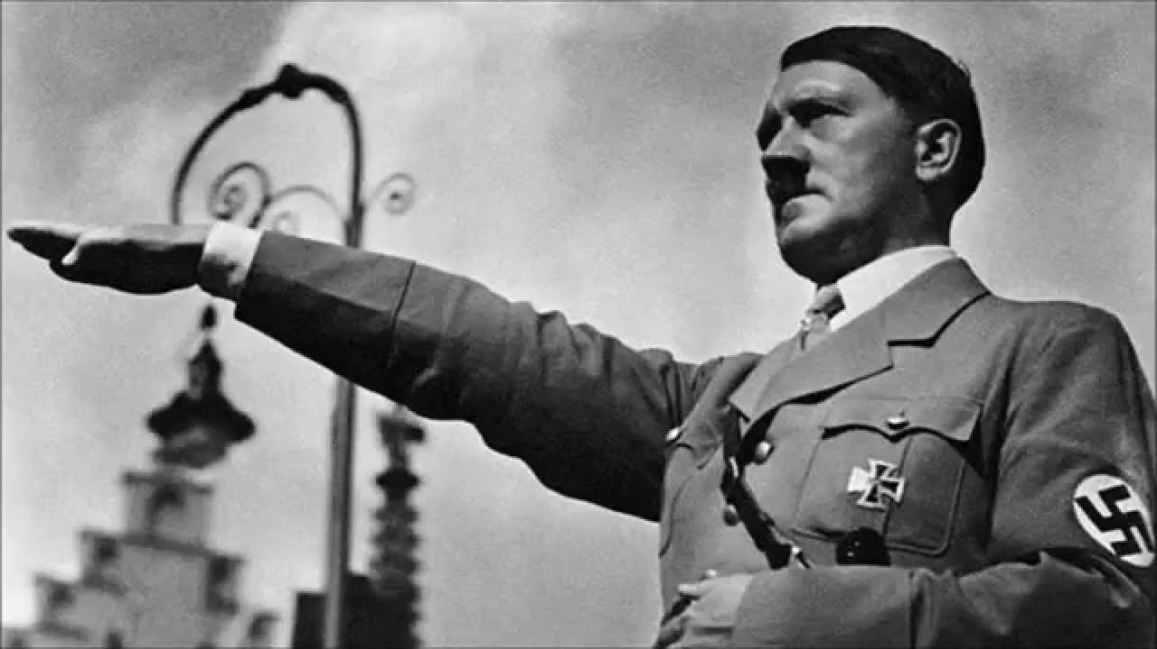
What factors shaped German foreign policy?
L/O – To identify the historical conditions, aims, and motives that helped form Germany’s expansionist foreign policy

Slide 2
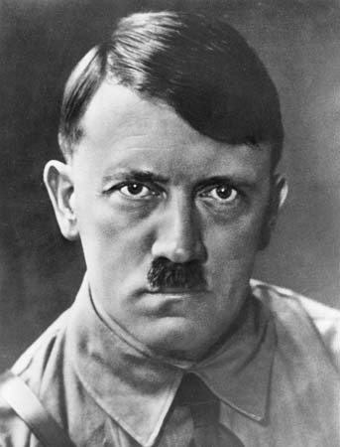
What influenced his foreign policy?
Hitler’s foreign policy was influenced and shaped by a number of factors.
These were a mixture of his own aims and motives, as well as domestic and international conditions that restrained or enabled the choices he took:
Legacy of Versailles
Racial Beliefs
Consolidating Power
Domestic problems
Nazi ideology
Contemporary events

Slide 3
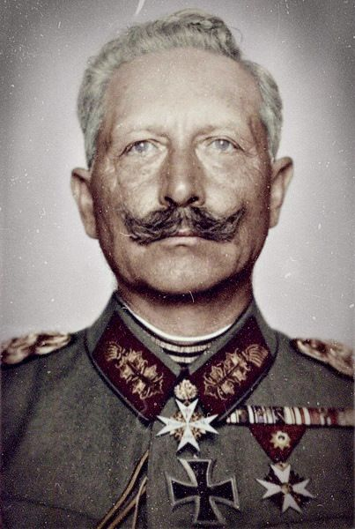
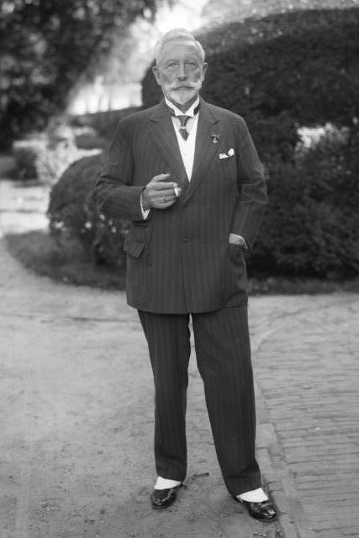
The Shock of Defeat on National Identity
Nazi ideology and Hitler’s foreign policy aims were not just shaped by, but created by the legacy of the First World War.
Under Kaiser Wilhelm’s expansionist foreign policy, Germany had fought in WW1 to protect and extend its territory and continental supremacy.
Defeat in 1918 shattered these plans, and the surprise abdication of the Kaiser on 9th November ruptured the very heart of the German state.

Slide 4
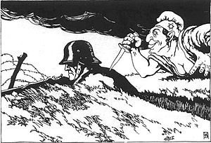
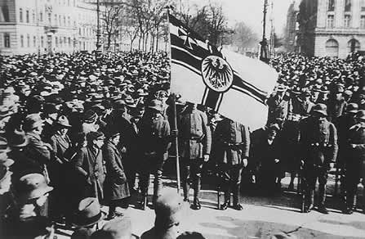
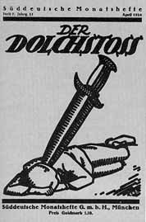
The Legacy of the War
The armistice that was signed on the 11th November came as a surprise to many Germans. Blame was heaped on the ‘November Criminals’ who had signed the armistice, thus the ‘stab-in-the-back’ myth was formed. This undermined the legitimacy of the newly created Weimar Republic.
Immediately, attempts were made to overthrow the government. The Sparticists tried in January 1919, then the Friekorps during the 1920 Kapp Putsch.
Both further undermined popular support for parliamentary government, whose ‘proportional representation’ system only served to create weak and indecisive coalition governments.

Slide 7
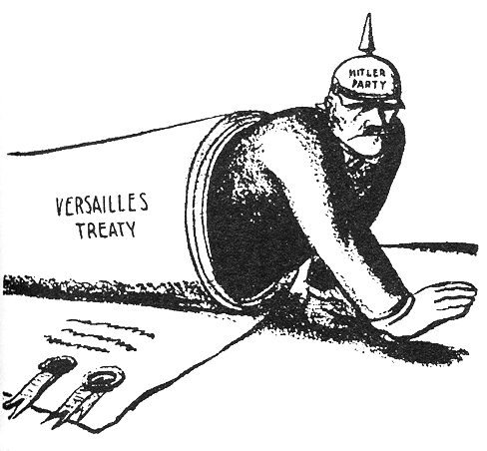
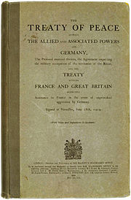
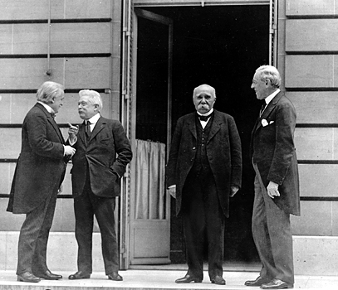
The ‘Diktat’
Lack of support in the new government was further increased by the outcome of the Paris Peace Conference on 28th June 1919.
The severity of the Treaty of Versailles spawned revisionist feeling amongst nearly all Germans and did more than anything to sow the seeds for political extremism within Germany.
War Guilt, disarmament, territory lost, colonies captured, no Anschluss, and reparations fixed at £6.6 billion in 1921 – not a recipe that Germans were happy to deal with.

Slide 11
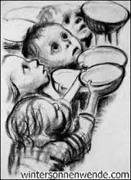
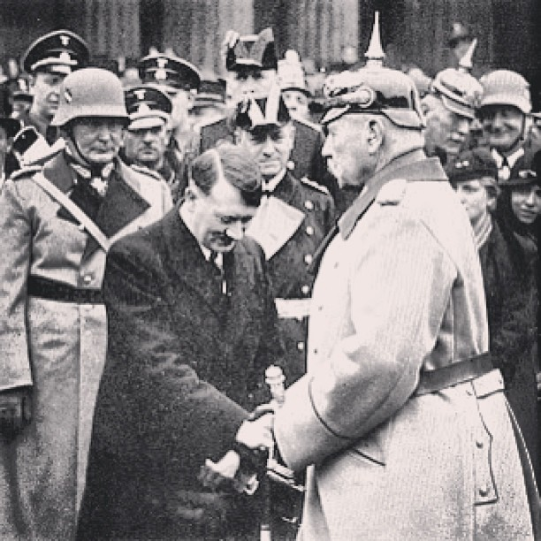
Economic Catastrophe
Economic crisis also exacerbated divisions with society. The Ruhr Crisis of 1923 would trigger hyperinflation within Germany, making the savings of millions worthless.
Despite a short-lived and American funded recovery in the 1920s, the 1929 Wall Street Crash and subsequent Great Depression plunged Germany back into crisis, with 1 in 3 unemployed and countless businesses bankrupt.
In these crisis conditions, Hitler’s NSDAP rose to become the largest party in 1932, with Hitler himself finally appointed Chancellor in 1933 – where upon he rapidly consolidated power into an authoritarian dictatorship.

Slide 12
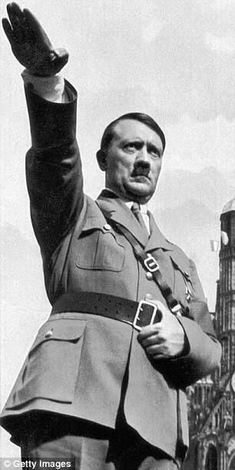
Hitler’s Foreign Policy Aims and Motives
Thus by 1933, mainstream political parties that had accepted the post-war international order had been defeated, in favour of an increasingly ‘revisionist’ NSDAP that had promised to ‘tear-up’ the Treaty of Versailles and restore Germany to greatness.
But Hitler’s foreign policy wasn’t just shaped by a sense of historical injustice. He didn’t just want to return Germany to its pre-WW1 position.
He also had other, larger foreign policy aims, which keen observers could have detected from his earlier published works.

Slide 13
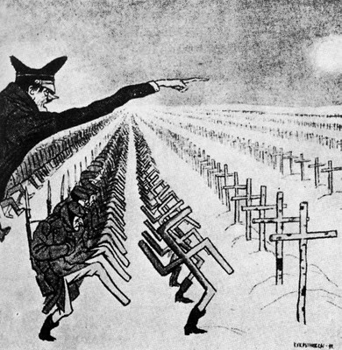
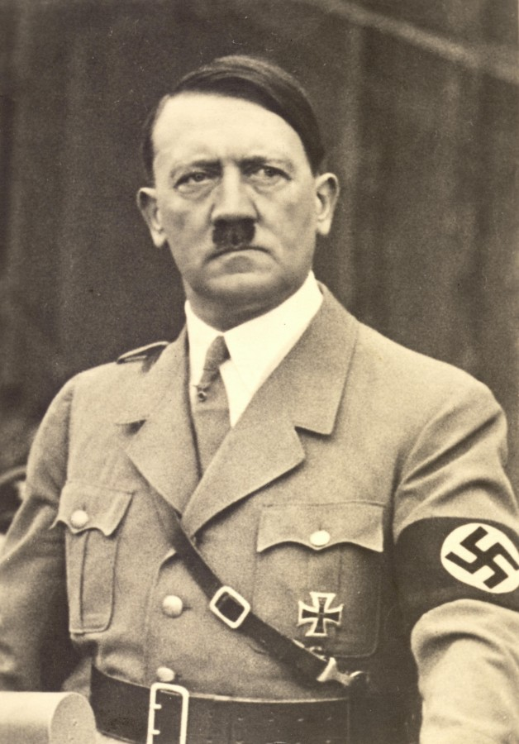
Source Analysis – Hitler’s Aims
With a partner, make a list of Hitler’s foreign policy aims outlined in Sources 1-4.
How, in Mein Kampf and the Zweite Buch, does Hitler justify German expansionism?
Which country is Hitler most hostile to? Why?
What change in his attitude to Britain occurs between Mein Kampf and the Hossbach Memorandum?
Why, in the Hossbach Memorandum, does Hitler argue that war for Lebensraum is required by the mid 1940s?
Which source do you consider to be most valuable in seeking to understand Hitler’s foreign policy? Refer to origin and content.

Slide 14
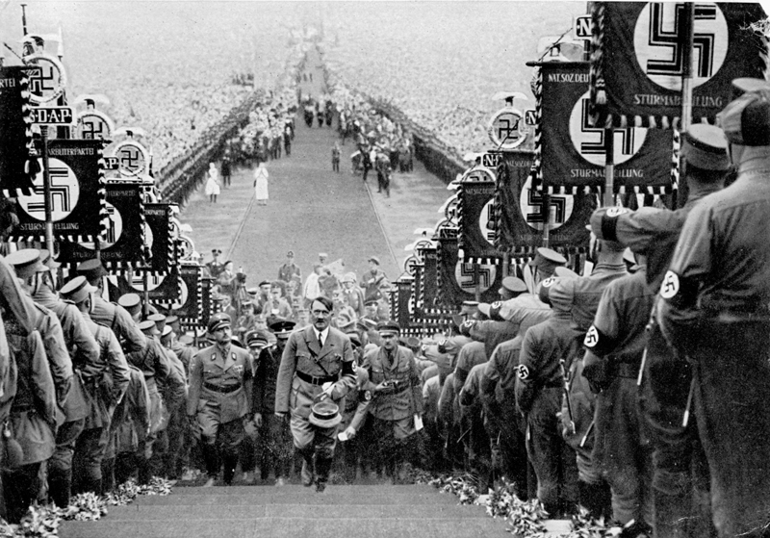
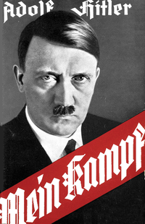
The International Context in the 1930s
So far you have seen how the legacy of the First World War provided fertile ground for extremism to flourish, which shaped the worldview of the NSDAP.
From the sources, you have seen how Hitler had his own unique aims and motives that went beyond simple revisionism.
Yet foreign policy isn’t made in a vacuum. Therefore, how did the international context in the 1930s help or hinder Hitler’s aims?

Slide 15
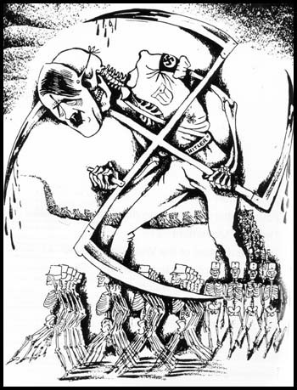
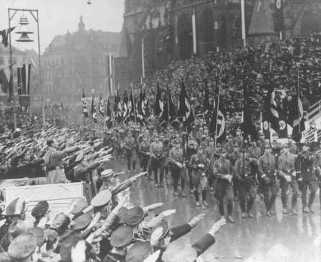
Source Analysis – International Context
Did the international context favour or hinder Hitler’s plans for German expansion?
Using Sources 5-8, list the factors that might have:
Helped Hitler revise the Versailles Settlement
Hindered Hitler revising the Versailles Settlement
Using the same sources, work out which country Hitler is describing in the speech bubbles on your worksheet.

Slide 16
What influenced his foreign policy?
As you have seen with Mussolini and now Hitler, foreign policy is…
Determined by the aims and motives of historical actors…
But constrained by historical conditions…
And helped or hindered by the contemporary international context
Racial Beliefs
Legacy of Versailles
Domestic problems
Consolidating Power
Nazi ideology
Contemporary Events

Slide 17
Viewpoints on Foreign Policy
Think about what you know of Hitler’s foreign policy so far – which viewpoint would you agree with the most and why?
Historians can be divided into three competing viewpoints on the nature of German foreign policy under Hitler:
Hitler the Evil One! – The German historian Klaus Hildebrand argues Hitler had a plan for war from the beginning (Intentionist)
Hitler the Blunderer! – British historian AJP Taylor controversially argued that Hitler was just like any European statesman, he blundered into a war he didn’t want in 1939, had no plan and simply took advantage of opportunities (Structuralist/Determinist)
Hitler the Pragmatist! – British historian Allan Bullock views Hitler as an opportunist adventurer, who was motivated by a lust for power to take advantage of events (Intentionist/structuralist)

